Slide 1

React
For Telenor Comoyo
March 31th 2014
Tor Arne Kvaløy

Slide 2
Major game changers
1999 Java
2002 XML
2004 Log4j
2005 JUnit
2006 Maven
2006 Spring
2007 Tomcat
2008 JQuery
2014 React

Slide 3
Current challenges
Long distance between template and model
Basically separating technologies
HTML/JSP and jquery
Mustache/Handlebars and JS-model
Bindings
Hard to test
Notes:
Separating technologies, not concerns.
jQuery spaghetti
MVC duct tape

Slide 4


Slide 5


Slide 6
React
Components
”Template” and ”model”
Inputs
State
Render themselves
Composable
Testable
Pre-rendered on the server

Slide 7
Hello World (component)
<div id=”hello”> </div>
--------------------------------------------------------------
var Hello = React.createClass({
render: function() {
return span(null, ”Hello World”);
}
});
React.renderComponent(Hello(), document.getElementById(”hello”));

Slide 8
Test
var hello = RTU.renderIntoDocument(Hello());
assert.equals(
hello.getDOMNode().firstChild.innerHTML,
”Hello World”);
Notes:
ReactTestUtility

Slide 9
Props and javascript
var List = React.createClass({
render: function() {
return ul(null,
this.props.names.map(function(name) {
return li(null, name);
}}
});
var names = [”James”, ”Paul”, ”Phillip”];
React.renderComponent(List({names:names}));
Notes:
The power javascript, not limited by a templating technology

Slide 10
Composition and props
var Hello = React.createClass({
render: function() {
return Heading({text = ”My heading”});
}
});
var Heading = React.createClass({
render: function() {
return h1(null, this.props.text);
}
});
Notes:
Components receive props
They can revieve data and functions
This enables reuse of components and boostraps

Slide 11
Composition and signature
var Hello = React.createClass({
render: function() {
return Heading({text = ”My heading”},
span(null, ”Hello World”));
}
});
var Heading = React.createClass({
render: function() {
return div(null,
h1(null, this.props.text),
this.props.children
}
});
Notes:
Components receive props
They can reveieve data and functions
This enables reuse of components and boostraps
signatur: props and children

Slide 12
Events, state, render and fun
var ClickMe = React.createClass({
getInitialState: function() {
return {clicks: 0};
},
handleClick: function() {
this.setState({clicks: this.state.clicks + 1});
},
render: function() {
return div(null,
button({onClick: this.handleClick}, ”Click me”),
div(null, ”Clicked ” + this.state.clicks + ” times”));
}
});
Notes:
- render: is pure, returns based on state,
Render is called when state is changed
Programming react is fun

Slide 13
References
var ClickMe = React.createClass({
getInitialState: function() {
return {clicks: 0};
},
handleClick: function() {
this.setState({clicks: this.state.clicks + 1);
},
render: function() {
return div(null,
button({onClick: this.handleClick, ref:”button”}, ”Click me”),
div({ref:”clicks”}, ”Clicked ” + this.state.clicks + ” times”));
}
});
Notes:
State

Slide 14
Test button click
var clickMe = RTU.renderIntoDocument(ClickMe());
RTU.Simulate.click(clickMe.refs.button.getDOMNode());
assert.equals(
clickMe.refs.clicks.getDOMNode().innerHTML,
”Clicked 1 times”);

Slide 15
render: function()
Returns a virtual DOM
Diffs it with the previous virtual DOM
Computes the minimal number of updates
Executes the updates

Slide 16
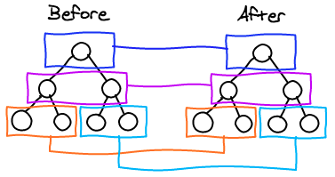
Diff algorithm - Level by level: O(n)

Slide 17
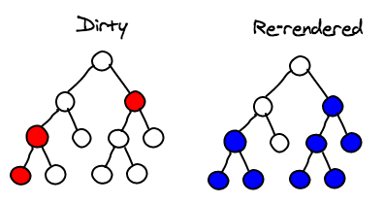
Diffs only dirty sub-trees

Slide 18
Pre-render on the server
Why?
Avoid waiting for javascripts to run
Search Engine friendly
Mobile/3G friendly
How?
React.renderComponentToString
data-react-checksum
Browser reveives complete HTML
Browser initialize React-components and compares the checksums
Only event handlers will be attached

Slide 19
State and flow
ButtonComp:
render: function() {
return
button({onClick:this.props.handleClick});
}
ClickMe:
getInitialState: function() {
return {click: 0};
},
handleClick: function() {
this.setState({clicks: this.state.clicks + 1);
},
render: function() {
return div(null,
ButtonComp({handleClick: this.handleClick}),
ClicksComp({click: this.state.clicks});
}
ClicksComp:
render: function() {
return h1(null, this.props.clicks);
}

Slide 20
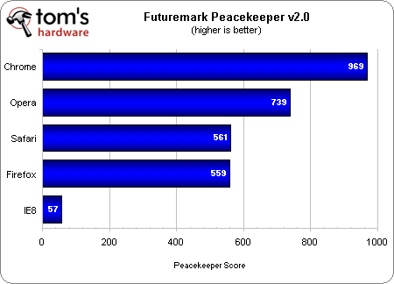
2,38 % on IE8

Slide 21
Statics
var MyComp = React.createClass({
statics:{
customMethod: function(){
return ”hello”;
}
},
render: function() {
….
}
});
Notes:
State

Slide 22
Test
var myComp = MyComp();
assert.equals(myComp.customMethod(),”Hello”)

Slide 23
Size
 | Minified | gzip
React | 112 | 31
Angular | 104 | 38
Ember | 263 | 73
JQuery | 83 | 29

Slide 24
React
Components
Inputs
State
Render themselves
Composable
Testable
Pre-rendered on the server

